Slide 1

IMAGE SCRAPPING AND CLASSIFICATION PROJECT
Submitted by:
Kishan Verma

Slide 2
INTRODUCTION
Image classification is a supervised learning problem: define a set of target classes (objects to identify in images), and train a model to recognize them using labeled example photos. Early computer vision models relied on raw pixel data as the input to the model. The position of the object, background behind the object, ambient lighting, camera angle, and camera focus all can produce fluctuation in raw pixel data; these differences are significant enough that they cannot be corrected for by taking weighted averages of pixel RGB values.
The advancements in the field of autonomous driving also serve as a great example of the use of image classification in the real-world. For example, we can build an image classification model that recognizes various objects, such as other vehicles, pedestrians, traffic lights, and signposts on the road.

Slide 3
The idea behind this project is to build a deep learning-based Image Classification model on images that will be scraped from e-commerce portal. This is done to make the model more and more robust.

Slide 4
ANALYTICAL PROBLEM FRAMING
Data for the project is being scrapped from amazon.in using python web scrapping libraries such as selenium, beautifulsoup, etc. More than 200 images of saree, jeans and trousers are scrapped for the project and saved into individual folders.

Slide 5
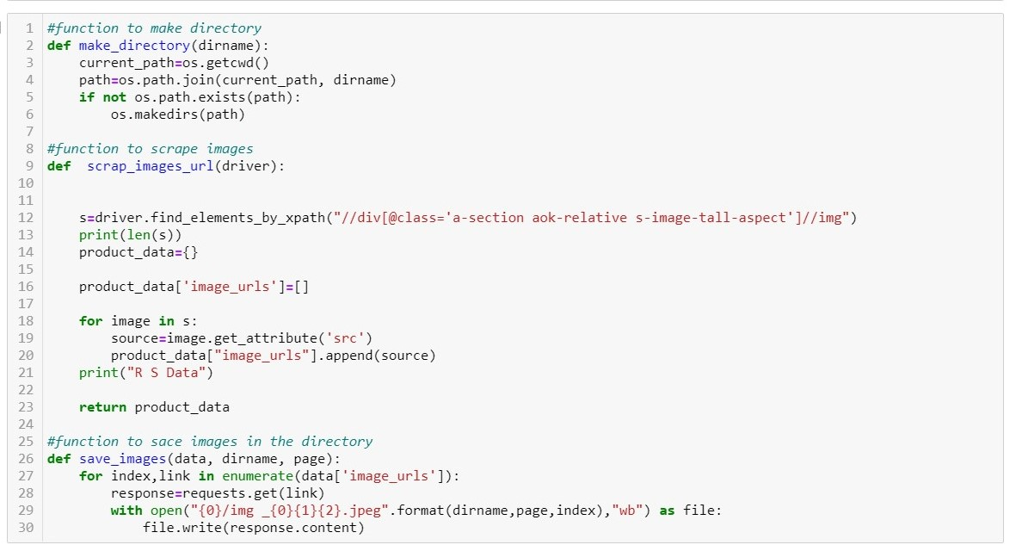

Slide 6
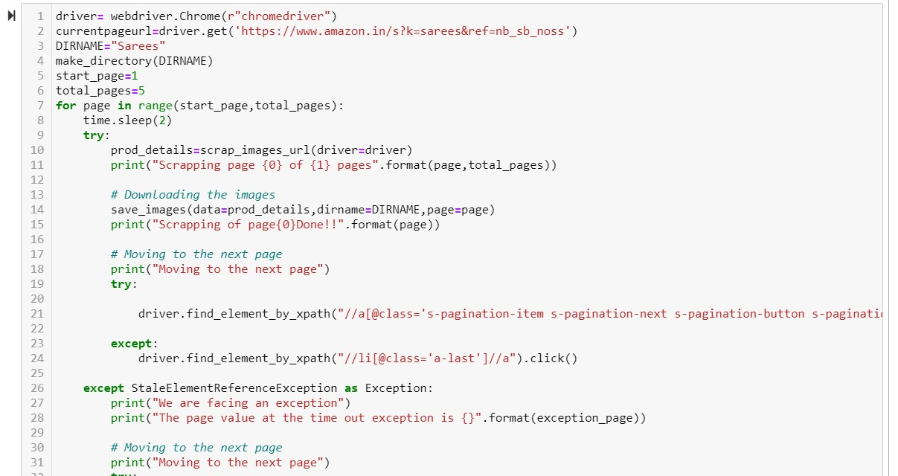

Slide 7
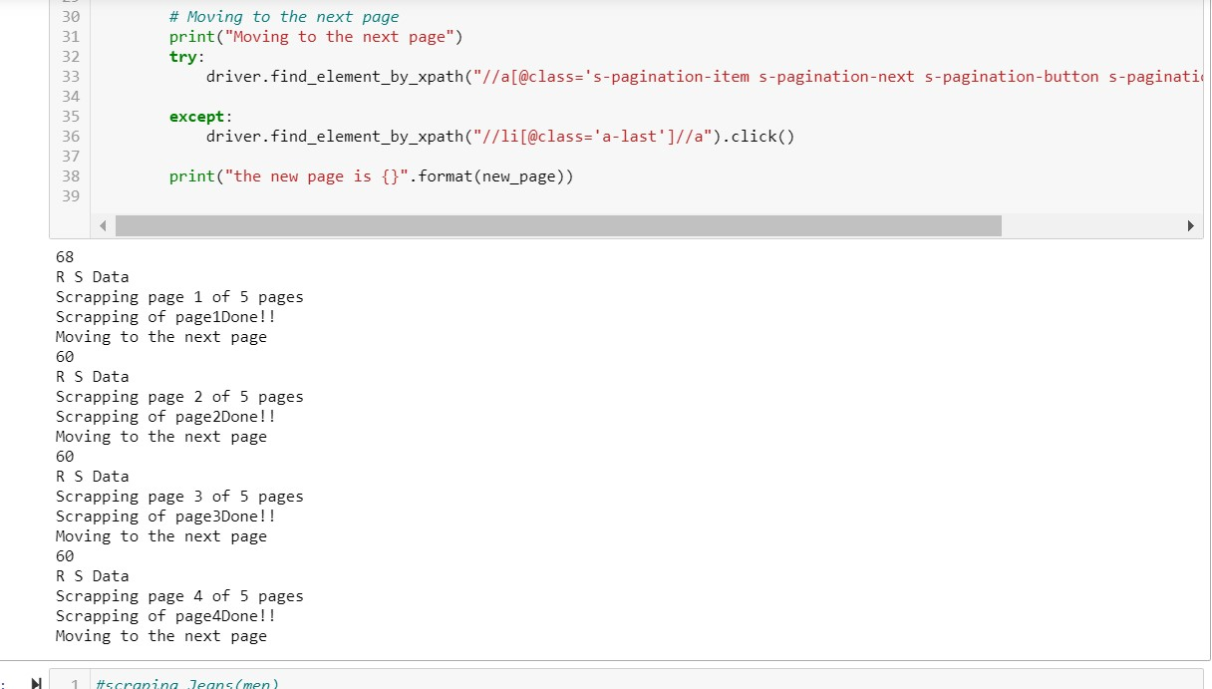

Slide 8
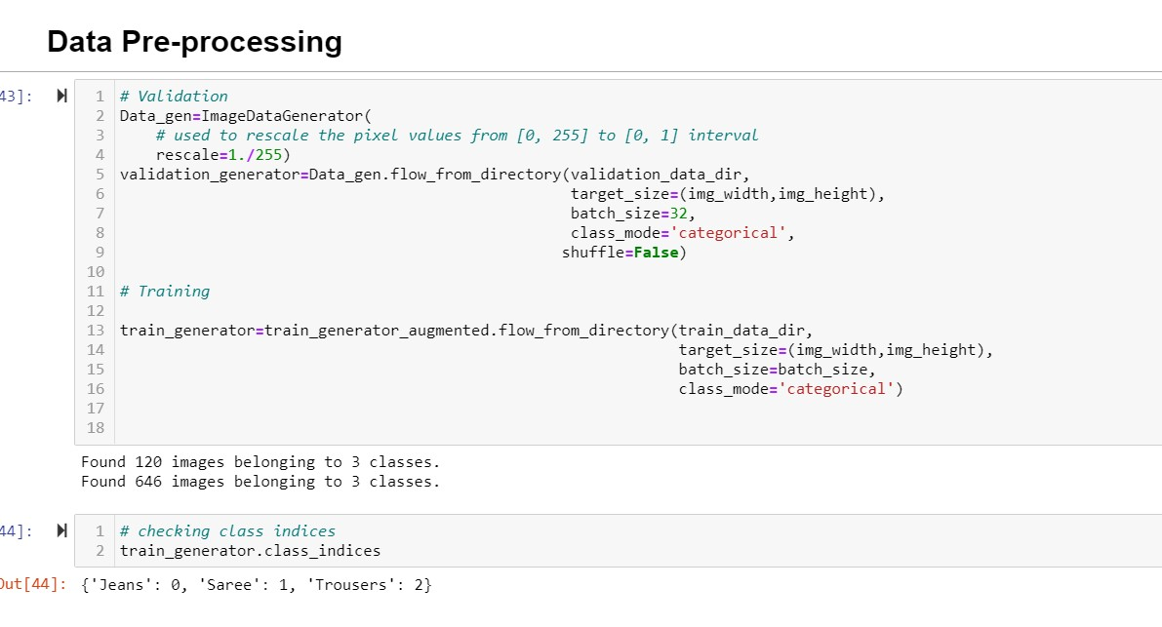
DATA PREPROCESSING

Slide 9
HARDWARE AND TOOLS USED
Hardware:
HP Pavilion x360
Software:
Jupyter Notebook (python- 3.9, TensorFolw- 2.5)
MS Office
Chrome web browser

Slide 10
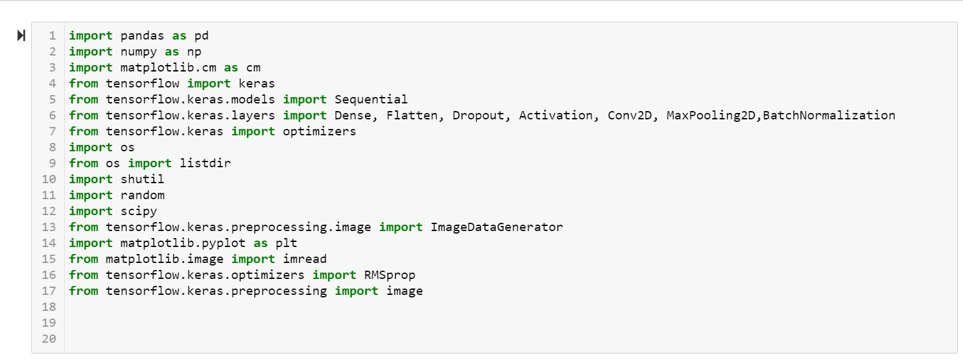
LIBRARIES USED

Slide 11
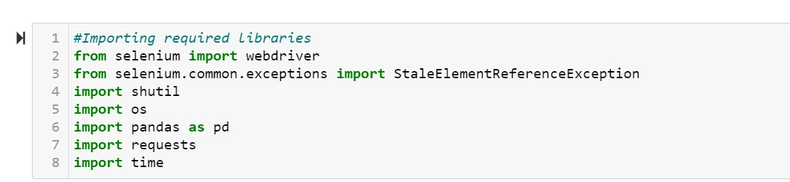

Slide 12
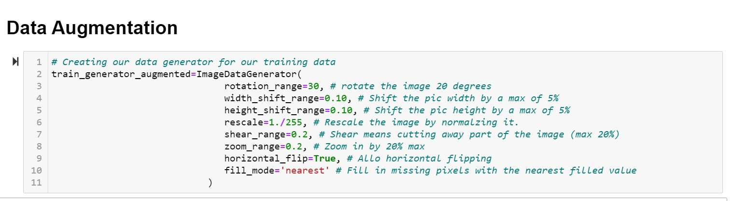
MODEL BUILDING

Slide 13
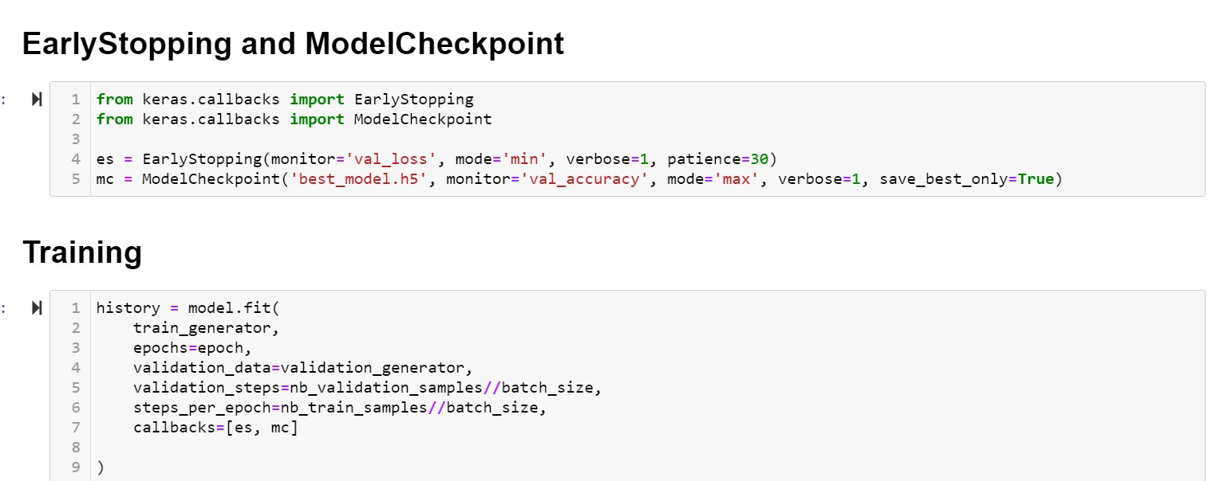

Slide 14
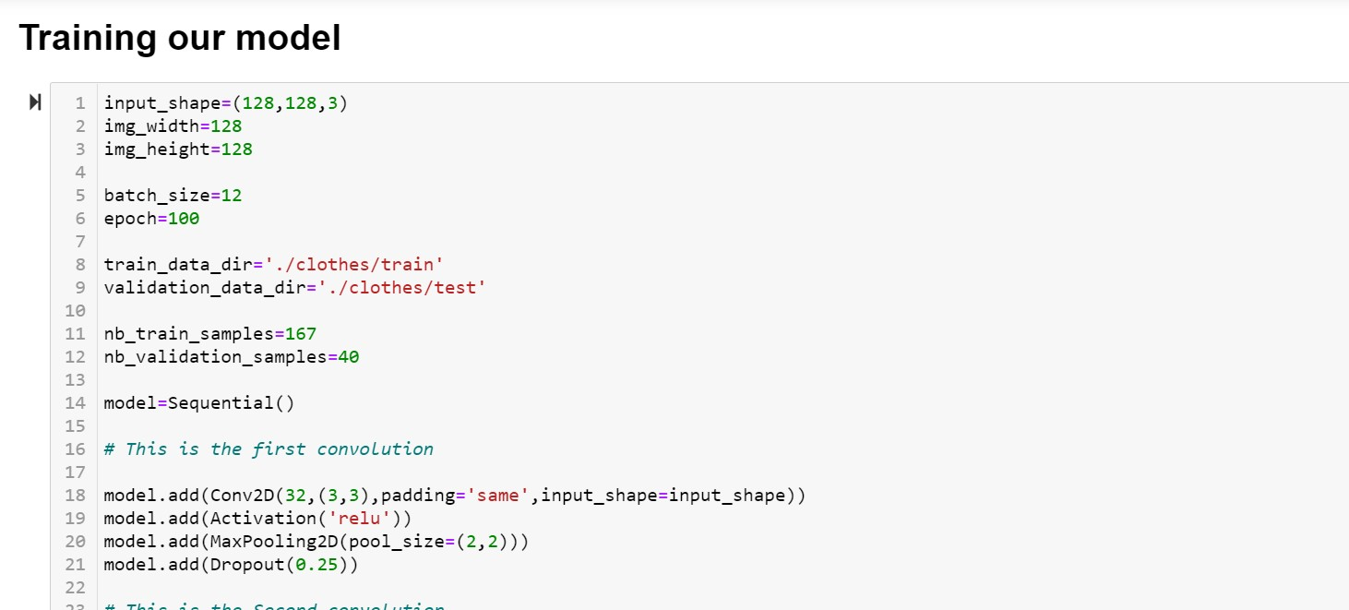

Slide 15
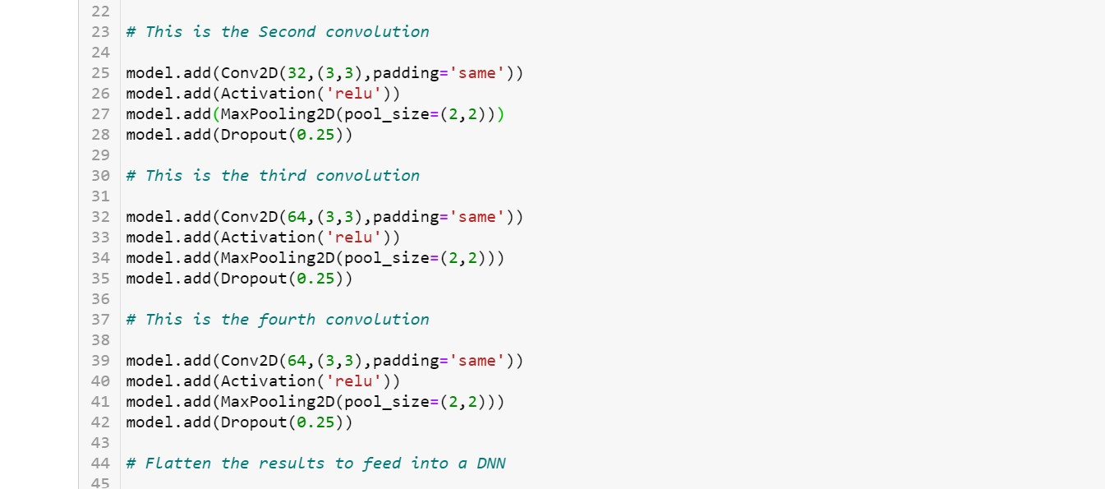

Slide 16
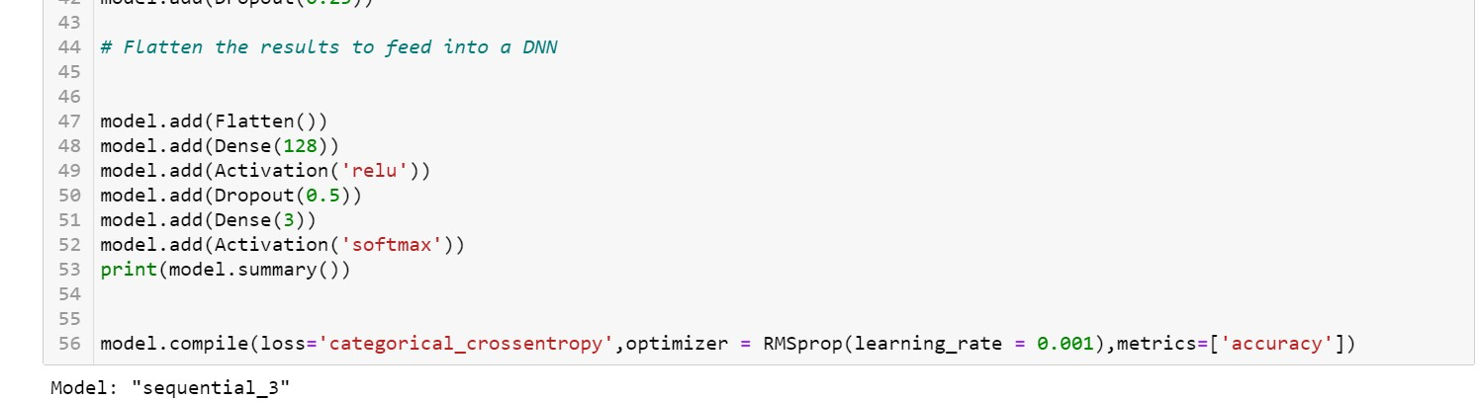
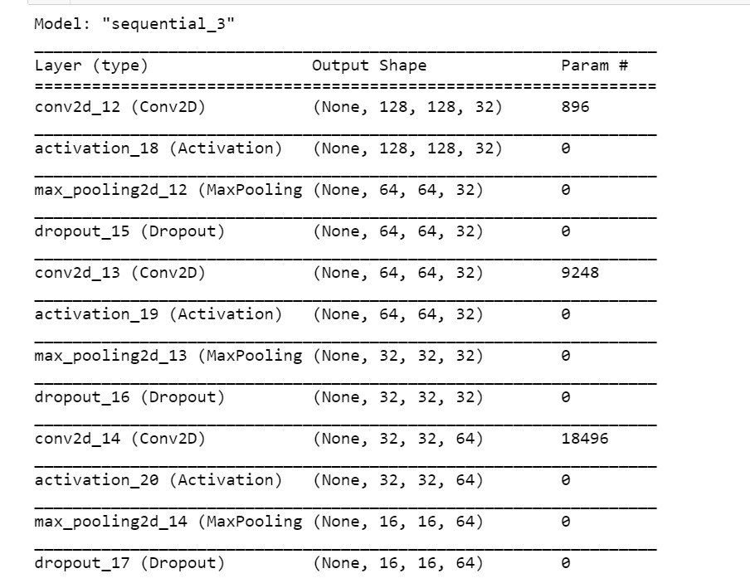

Slide 17
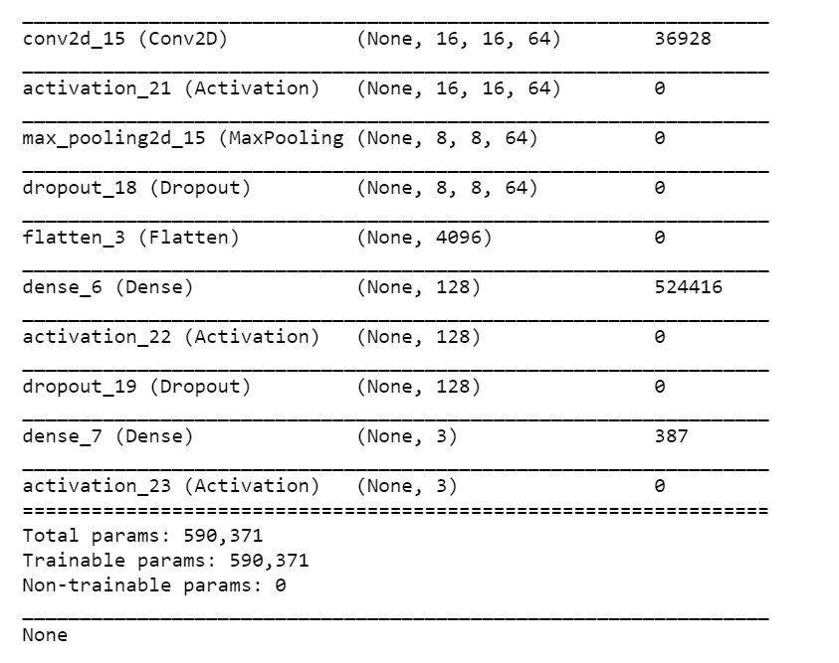

Slide 18
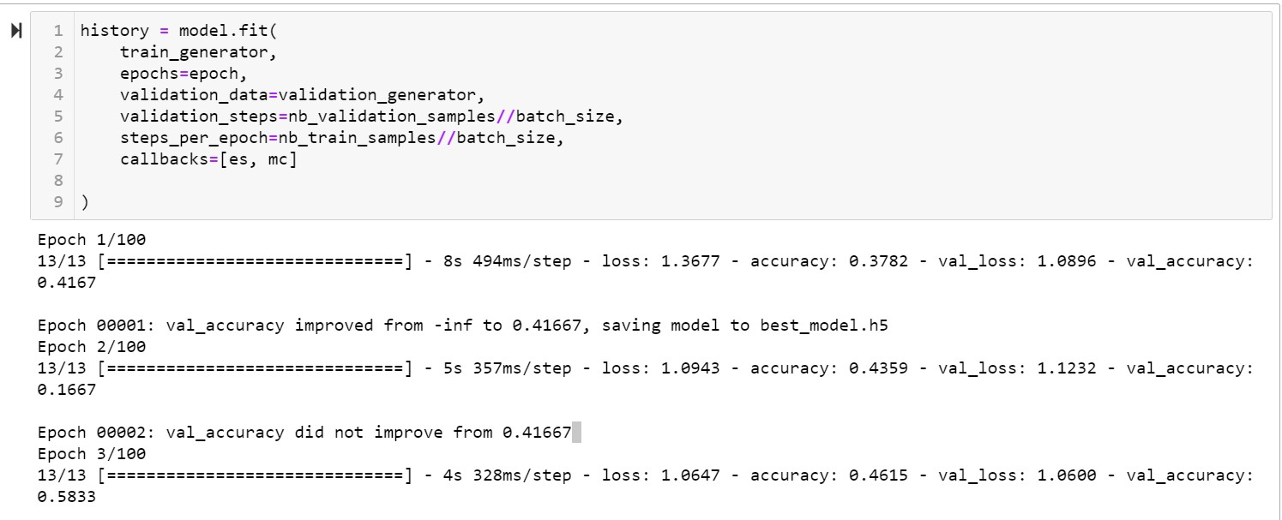

Slide 19
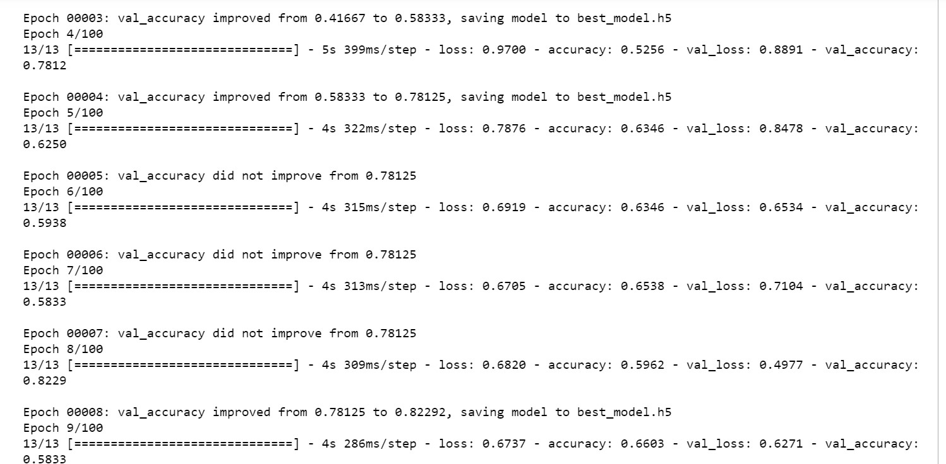

Slide 20
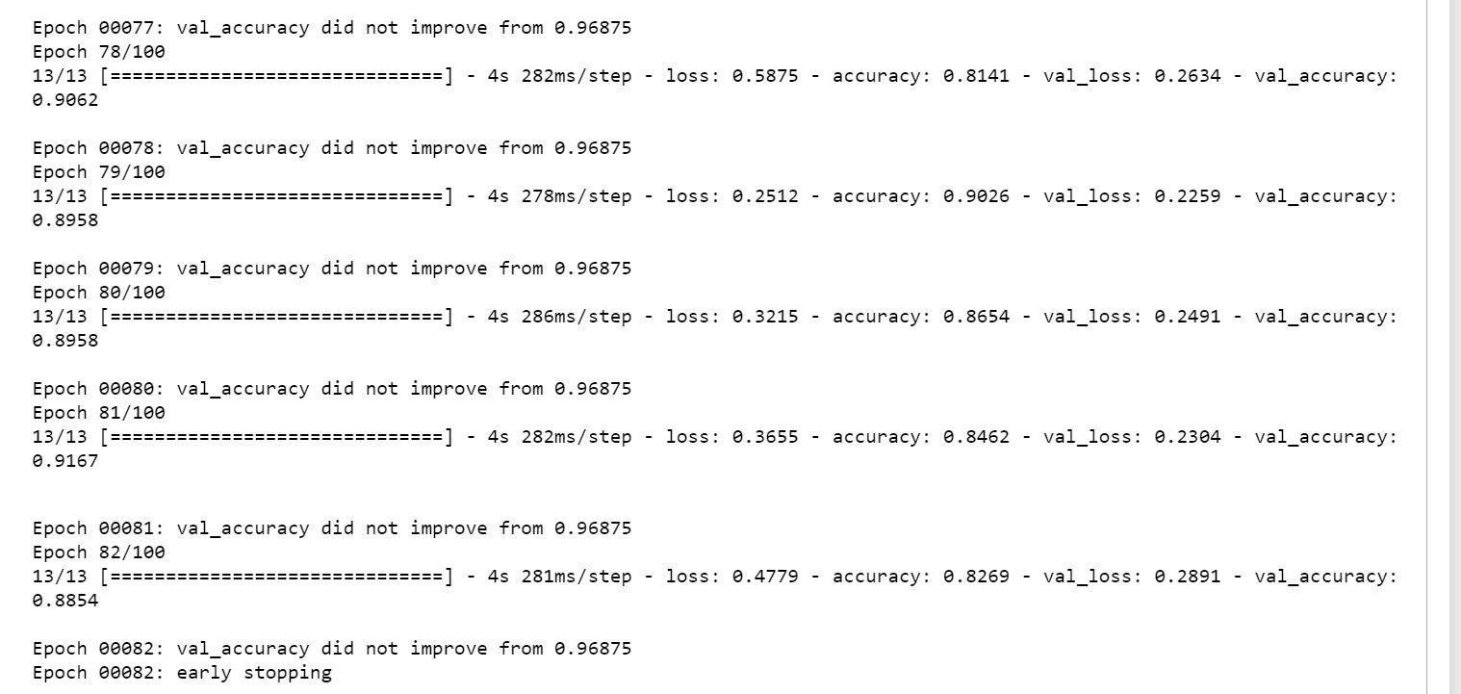

Slide 21
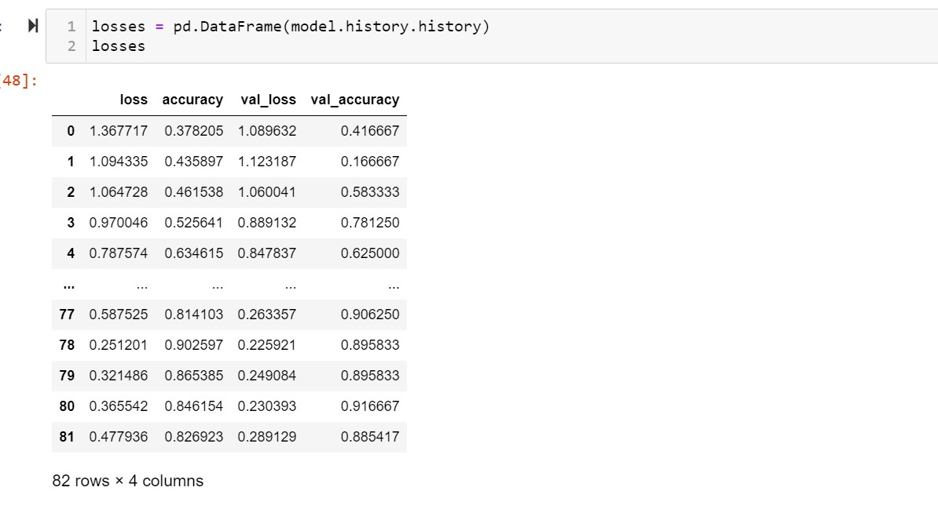
KEY METRICS FOR SUCCESS IN SOLVING PROBLEM UNDER CONSIDERATION

Slide 22
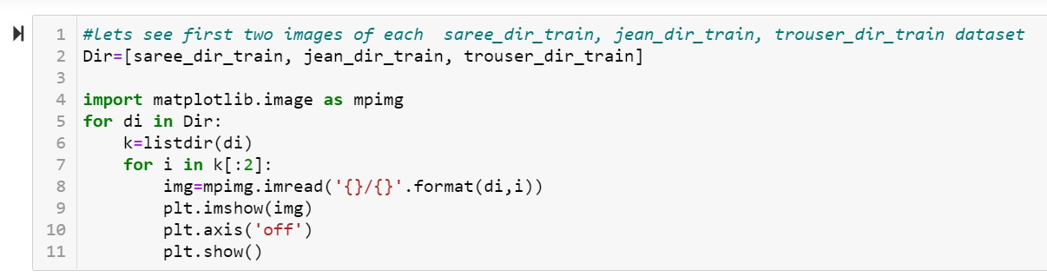
VISUALIZATION

Slide 23

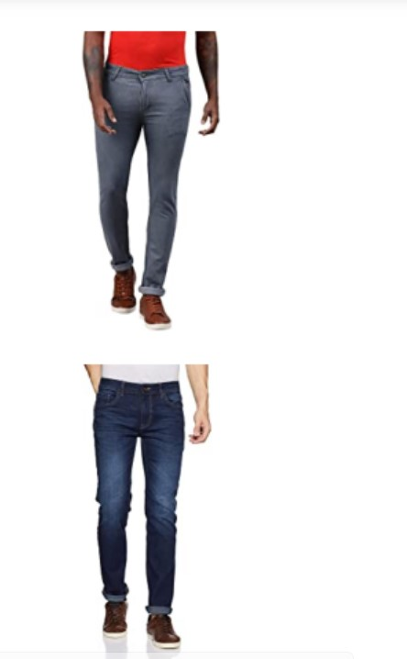

Slide 24
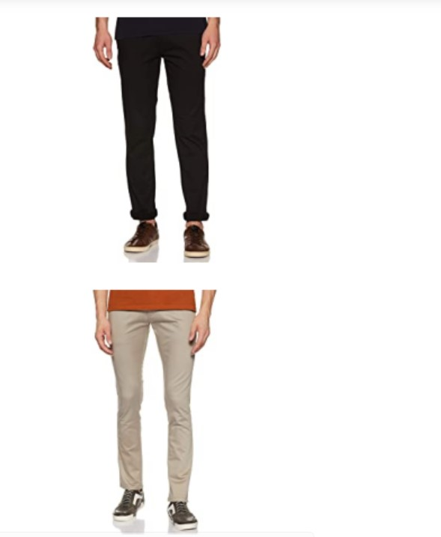

Slide 25
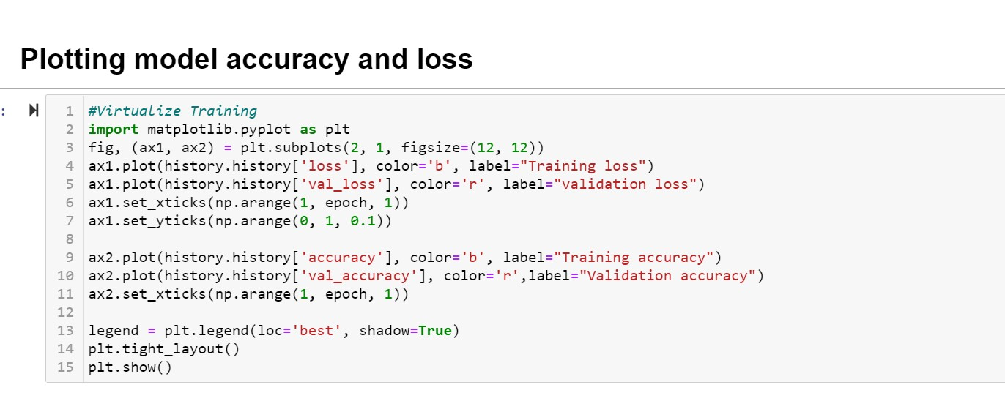
INTERPRETATION OF THE RESULTS

Slide 26
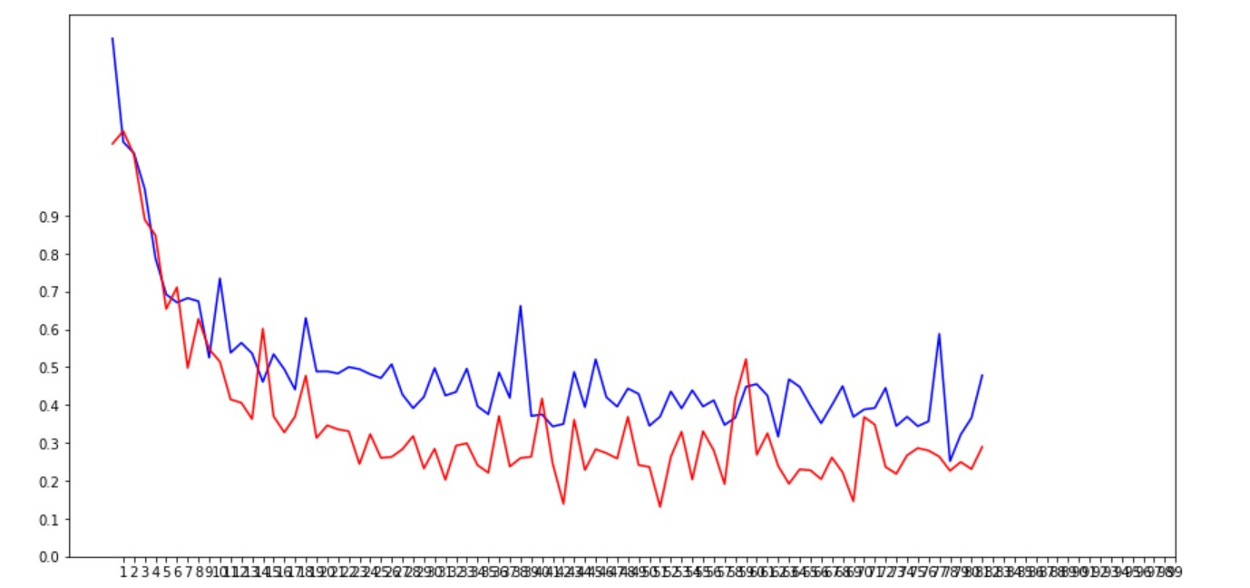
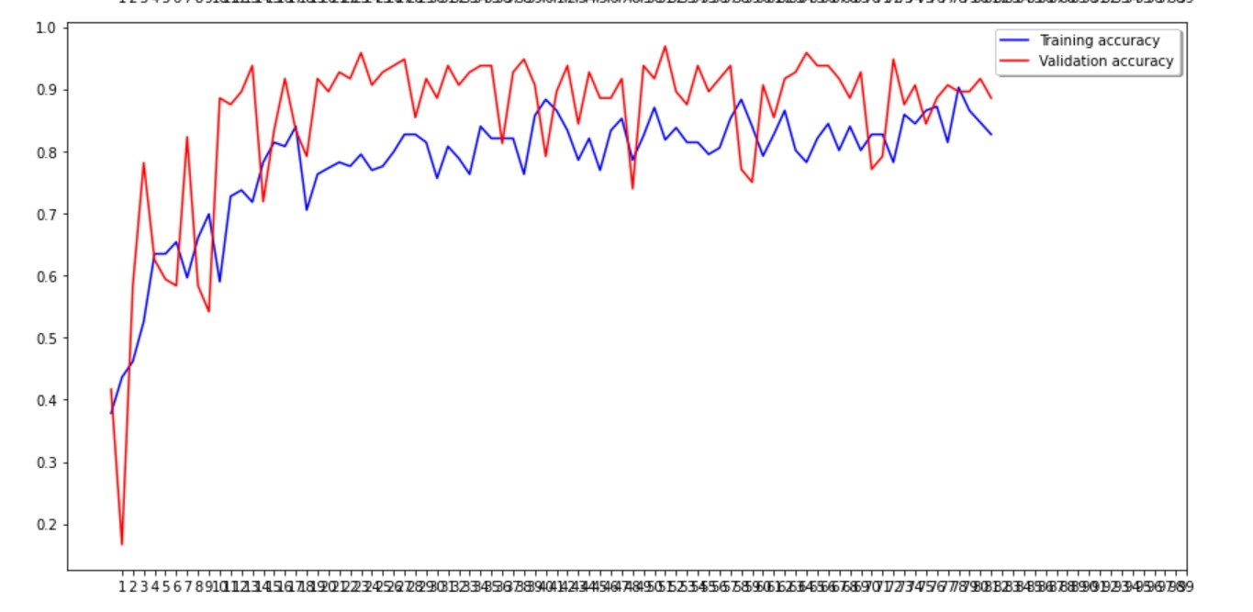

Slide 27
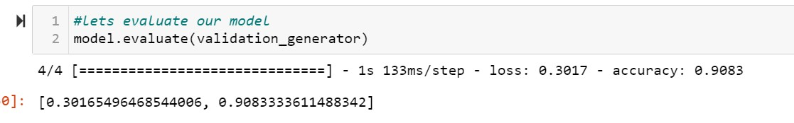
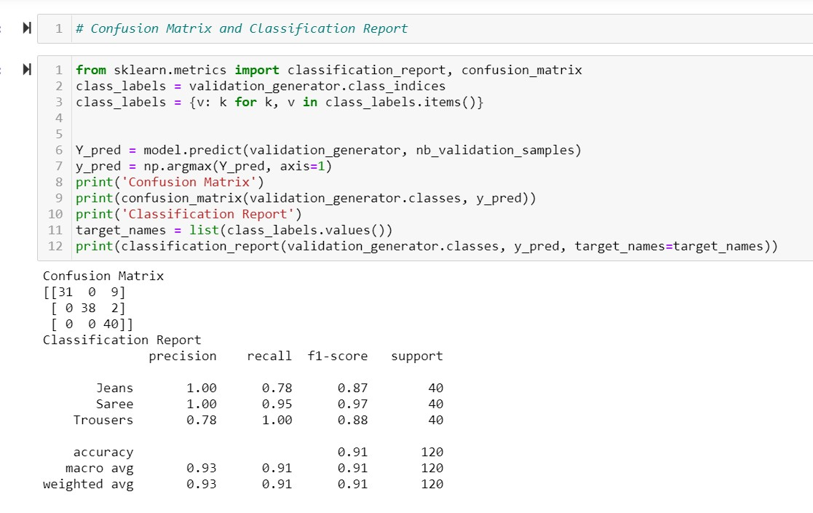

Slide 28
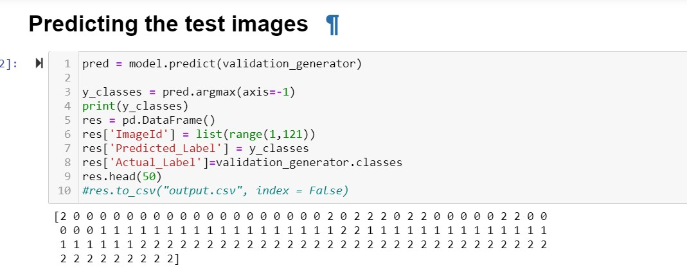
CONCLUSION

Slide 29
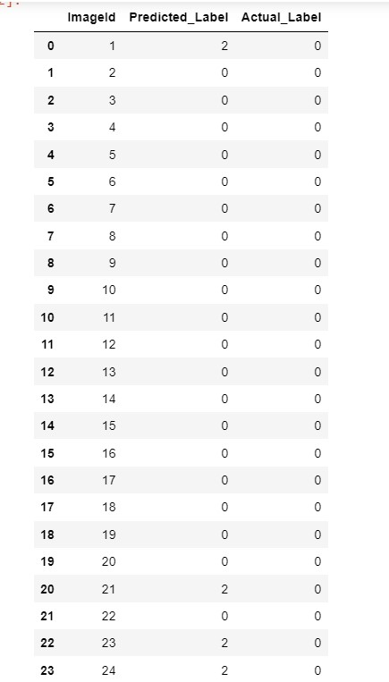
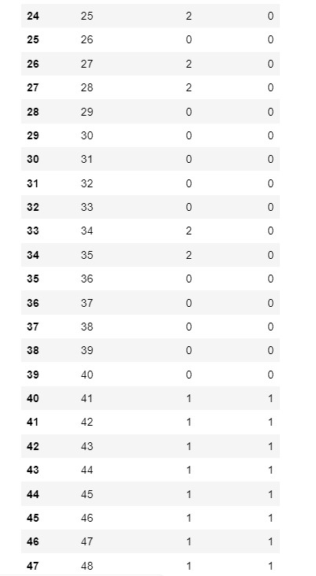

Slide 30
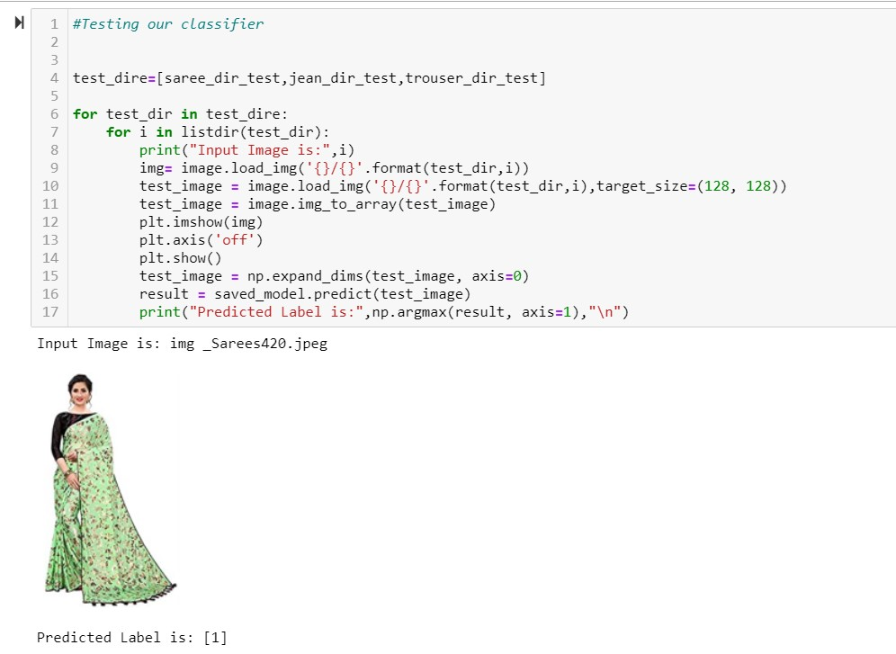

Slide 31
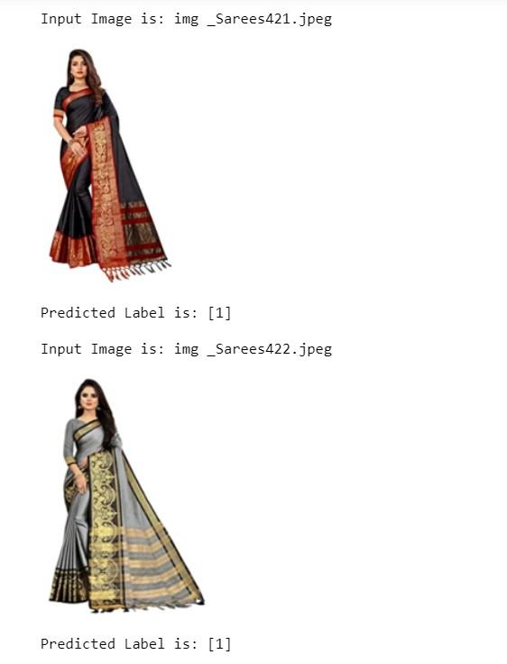

Slide 32
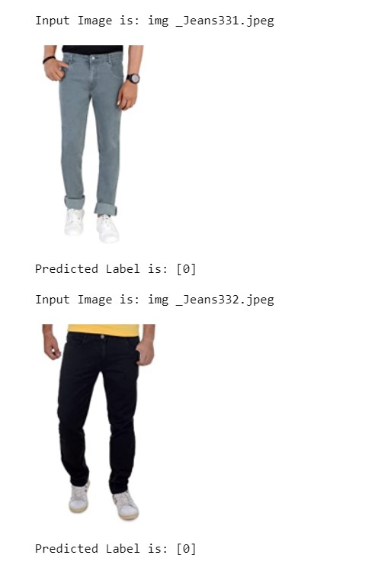
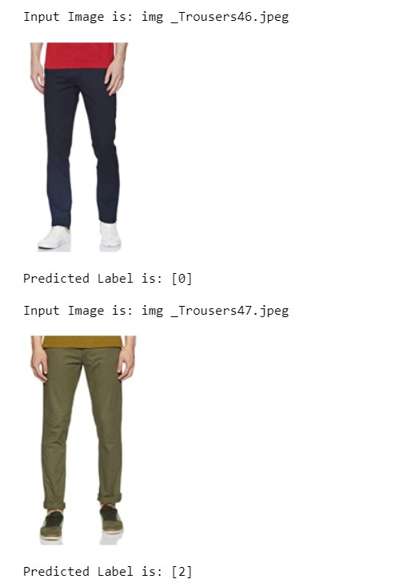

Slide 33
THANK YOU

